Slide 1
Image and Video Processing
Meme Based Cyberbullying Detection
Under the guidance of Dr. Anupam Agrawal

Slide 2
Group Number 7
IIT2021109: Rajat Srivastava
IIT2021166: Nikunj Gupta
IIT2021168: Kaushik Mullick
IIT2021170: Viraj Jagtap
IIT2021184: Kuber Jain
IIT2021192: Dhairya Bhadani
IIT2021207: Sanyam Agrawal

Slide 3
These slides are only for research purposes and we do not intend to offend anyone in any way whatsoever.

Slide 4
Table of Contents
What is a meme?
What is cyberbullying?
Cyberbullying through memes
Scope of the Project
Literature Review
Understanding Datasets
Block Diagram of the System
Software Requirement Specifications
Understanding OCR
Implementation of BERT
When OCR is not enough
VCG and ReLU
Advantages of the model
Limitations of the model
Results and Conclusion
References

Slide 5

What is a meme? [11]
"Memes" are rapid, humorous, or satirical cultural artifacts in the digital realm.
They come in various formats: images, videos, and textual constructs, adaptable and contextually reconfigurable.
Internet memes cover diverse subjects, from socio-political commentary to popular culture references.
They serve as a medium for internet users to engage with and comment on contemporary society.
Memes encapsulate multifaceted expressions and insights within a concise digital framework.
Reference

Slide 6
What is Cyberbullying? [10]
Cyberbullying is a form of harassment and aggression conducted through digital means.
It occurs across various online platforms and communication channels.
Involves using technology for persistent, hostile, or damaging actions towards individuals.
Intent is to inflict emotional, psychological, or social harm.
Takes diverse forms, including hurtful messages, unauthorized sharing of private content, spreading false information, and posting derogatory comments or images.
Consequences are profound, leading to emotional distress, anxiety, depression, and, in extreme cases, physical harm or self-endangerment.

Slide 7
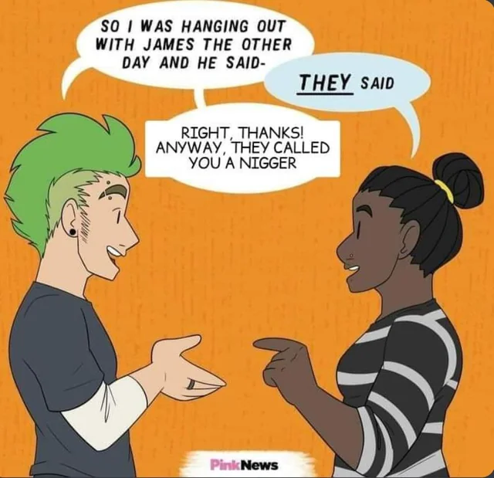
Cyberbullying through memes. [10]
Cyberbullying via memes involves using digital humor to maliciously target individuals.
Intent is to cause emotional distress, social harm, or damage to reputation.
Memes, typically used for humor or satire, are repurposed to perpetrate hurtful narratives.
Manipulative visuals/messages include personal attacks, derogatory comments, false allegations, and unauthorized sharing of sensitive information.
Dissemination occurs widely on digital platforms.
Reference

Slide 8
How do you detect it?

Slide 9

Scope of the Project [5]
Output is cyberbullying
Detection of Hate Speech in Memes: Our algorithm focuses on the challenging task of identifying hate speech within the unique context of memes. Hate speech can manifest in various forms, often hidden behind humor, coded language, or visual elements. By targeting memes, we aim to uncover such content that might otherwise go unnoticed in traditional text-only analysis.
Multimodal Approach: To achieve a thorough analysis, we adopt a multimodal approach that combines both text and image analyses. By simultaneously considering linguistic and visual cues, we can capture the intricate interplay between textual and visual components in memes. This comprehensive analysis enhances the accuracy of our detection algorithm.
This contribution aligns with the larger mission of fostering inclusive and respectful online communities for all users.
Ref
OUR SYSTEM

Slide 10
LITERATURE REVIEW
Link to the Literature Review Tables :-
https://www.notion.so/LR-Table-90266e3c3c794b719b0beddb3b7329e3

Slide 11
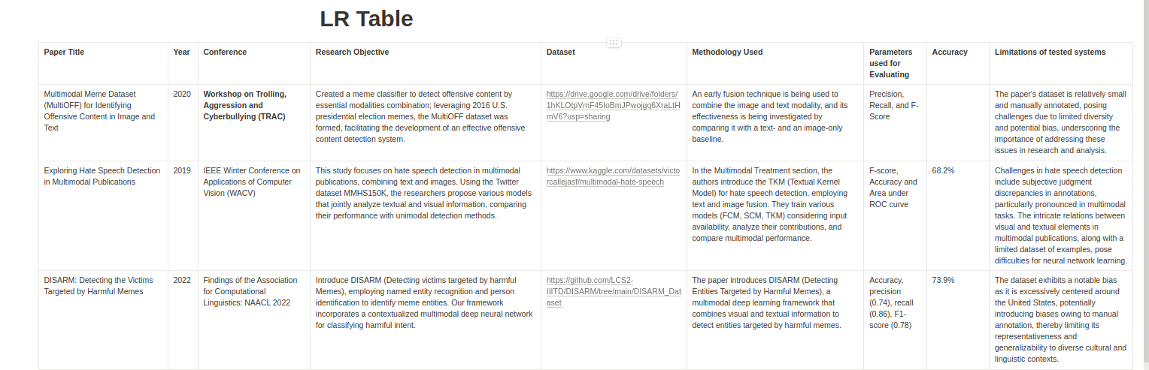
LITERATURE REVIEW

Slide 12
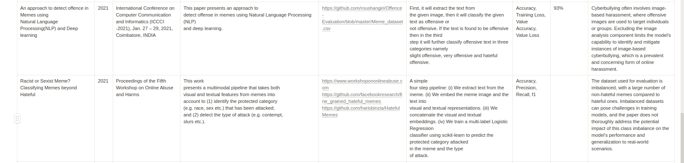
LITERATURE REVIEW

Slide 13
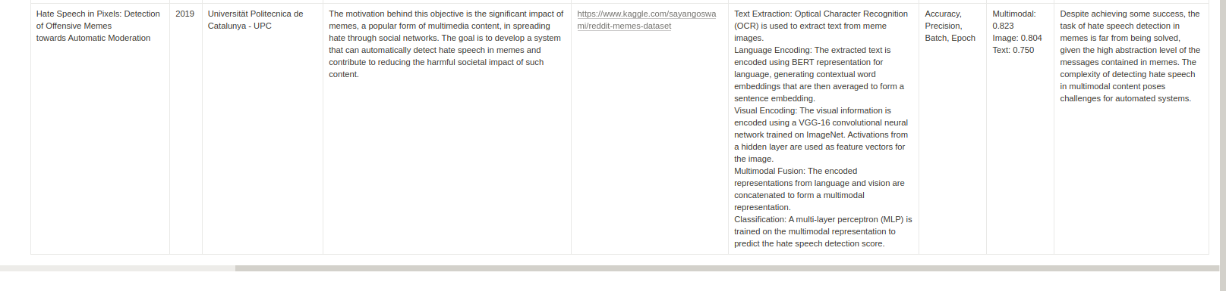
LITERATURE REVIEW

Slide 14
Dataset
We would require a dataset that would align with our vision of detecting cyberbullying.
For this, we would need
Hateful Memes Dataset
Non-Hateful Memes Dataset
Dataset Split
The dataset combination enables comprehensive model training, validation, and effective cyberbullying detection in memes.

Slide 15
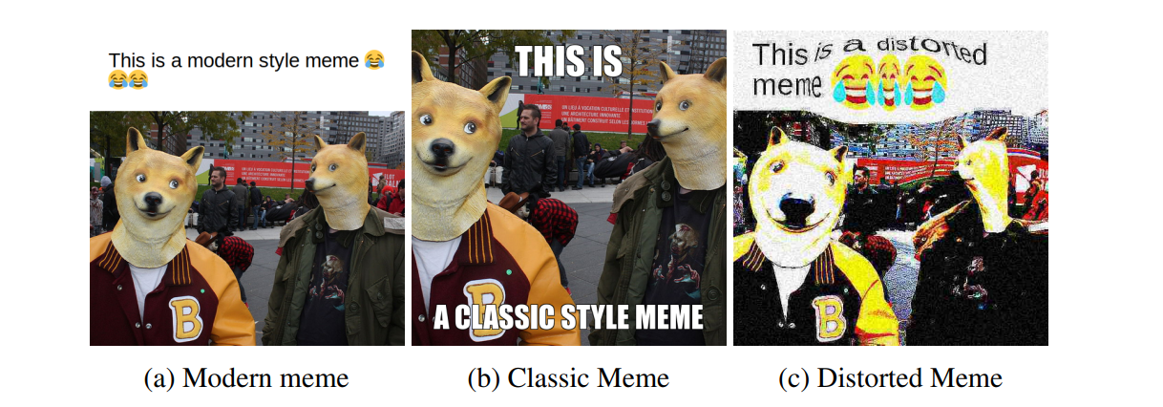
Understanding the Types of Memes [9]

Slide 16
Usage of the Dataset [4] , [5]
Based on our needed use we can use the following datasets: -
Hateful Memes Dataset by Facebook:
Contains 10,000+ multimodal examples (text and images).
Specially designed to understand and detect harmful content.
Reddit Memes Dataset :
Comprises 3,325 non-hate memes.
Assumed to contain non-hateful content.
Used for contrast and validation.
The combination of both datasets enables robust training and evaluation of our cyberbullying detection model.
Dataset Split is 85%-15% for training and testing

Slide 17
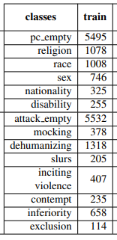
Explanation of Dataset
We assume that the dataset of Reddit memes contains only non-hateful memes to train the model.
The Hateful Memes Dataset by Facebook can be classified as follows: -
Reddit Meme Dataset: https://www.kaggle.com/datasets/sayangoswami/reddit-memes-dataset [5]
Hateful Memes Dataset: https://www.kaggle.com/datasets/parthplc/facebook-hateful-meme-dataset [4]
[4]

Slide 18
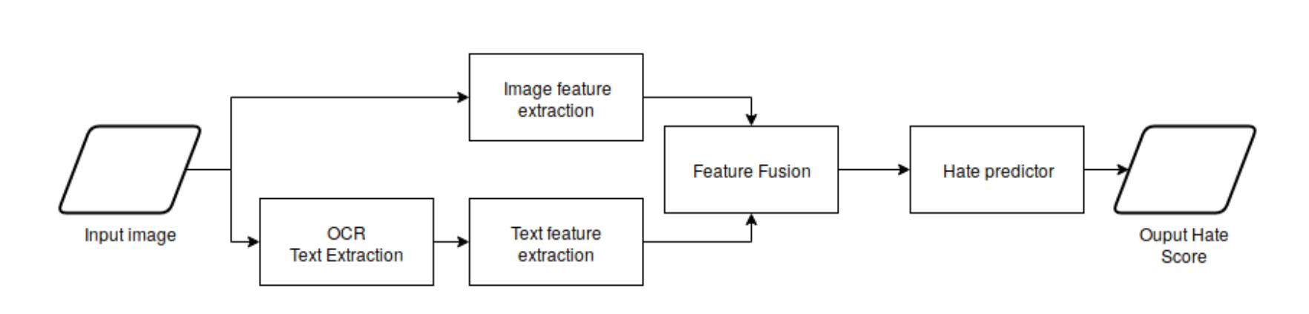
Block Diagram of the System [5]
Using VGG 16
4096 feature vector
4864
Dimensions
768 feature vector
Tesseract OCR 4.0.0.0
Using BERT

Slide 19
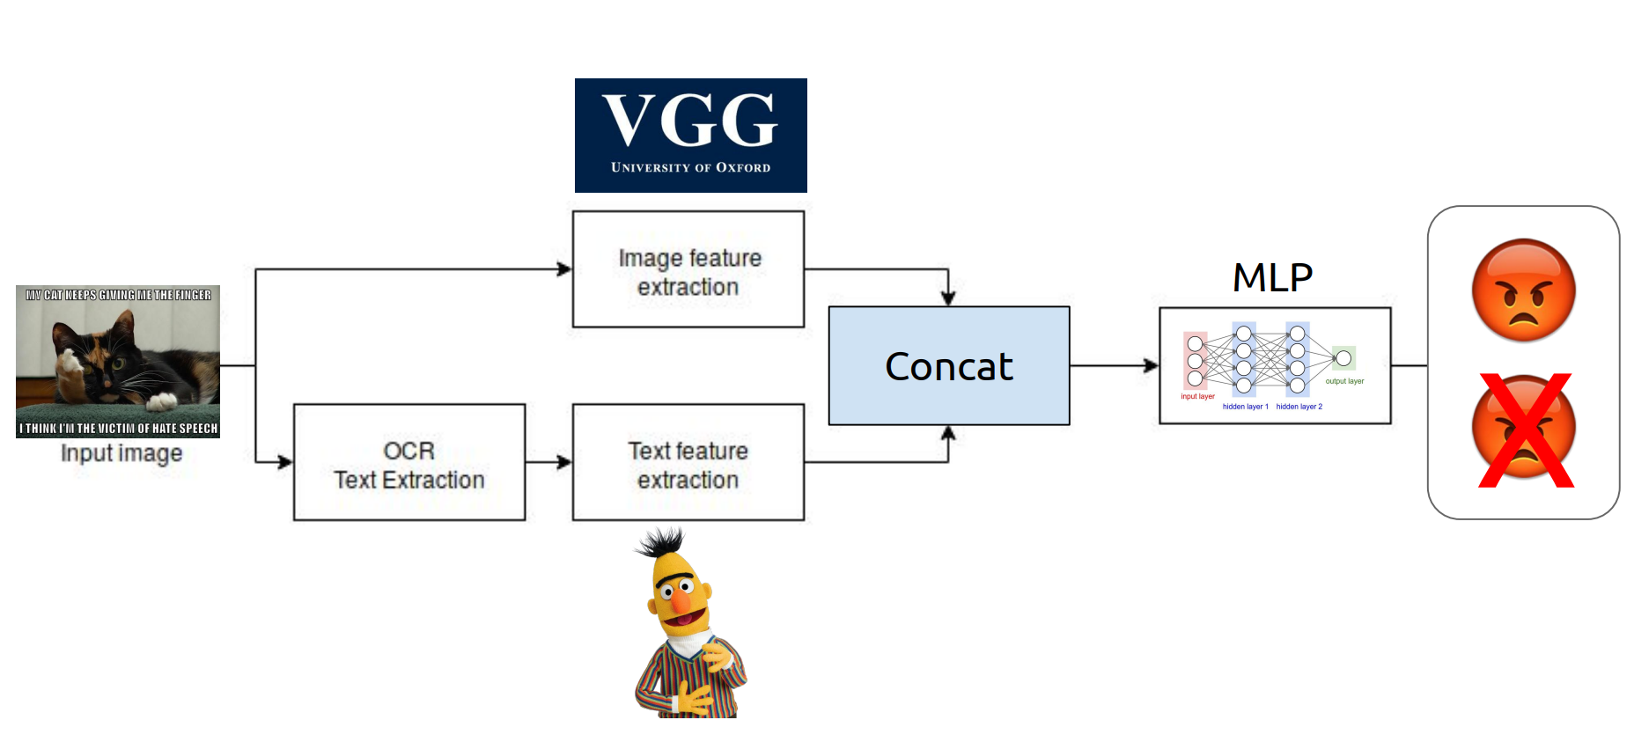
4096 Dimensions
4864
Dimensions
BERT
768 Dimensions
Using Tesseract OCR - 4.0.0.0
[9]

Slide 20
Software Requirements Specifications (SRS) [5]
Functional Requirements: -
Text Extraction using OCR
Implement Optical Character Recognition (OCR) to extract text from memes.
Utilize Tesseract 4.0.0 OCR tool for accurate text extraction.
Ensure seamless integration of OCR component into the algorithm.
Text Encoding using BERT
Apply BERT encoding to the extracted text.
Use "bert-base-multilingual-cased" version with 12 layers and 768 dimensions.
Integrate PyTorch implementation of BERT for consistent encoding.
Image Extraction using VGG-16 CNN

Slide 21
Software Requirements Specifications (SRS)
Employ VGG-16 CNN pretrained on ImageNet for feature extraction.
Extract activations from the last hidden layer (4096 dimensions) for images.
Integrate VGG-16 into the algorithm's image processing module.
Multimodal Fusion and Feature Vector Generation
Concatenate encoded text features and image features.
Create a multimodal feature vector of 4,864 dimensions (768 + 4096).
Implement a multi-layer perceptron (MLP) for hate speech detection.
Design two hidden layers, each with 100 neurons and ReLU activation.

Slide 22

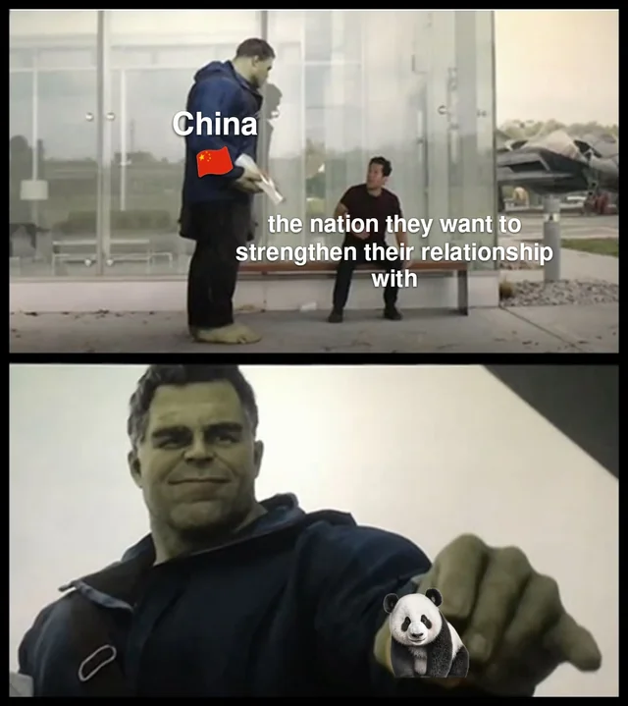
A General Overview
😡
OUR SYSTEM
😊
Reference

Slide 23
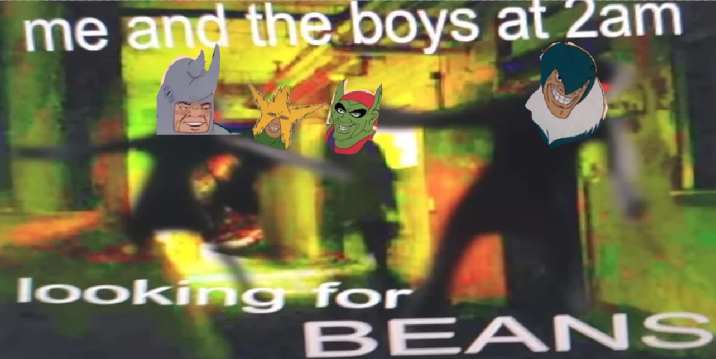
Text Extraction: Optical Character Recognition [5]
In the realm of meme analysis for cyberbullying detection, text content embedded within memes plays a crucial role in conveying messages, emotions, and potentially harmful content. To initiate the detection process, our algorithm employs Optical Character Recognition (OCR), a technology designed to extract text from images, enabling us to scrutinize the textual components of memes.
Ref
Me and the boys at 2 AM looking for beans

Slide 24
Understanding OCR
OCR technology converts text in images or into machine-readable text.
It uses advanced pattern recognition to identify and interpret characters, words, and sentences.
OCR makes textual content accessible for further analysis.
It's relevant in meme contexts where images are combined with text for meaning.

Slide 25
The Tesseract 4.0.0. OCR Tool [5]
Text extraction is performed using the Tesseract 4.0.0 OCR tool.
Tesseract is a well-known OCR engine developed by Google.
It is widely recognized for its accuracy and efficiency in extracting text from images.
Tesseract is capable of handling the complexities of extracting text from memes with diverse fonts, styles, and sizes.

Slide 26
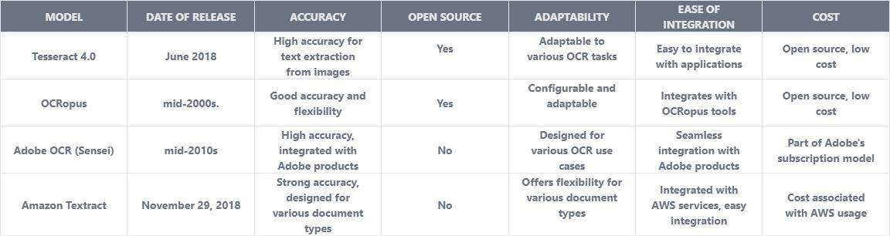
The Tesseract 4.0.0. OCR Tool [5]

Slide 27
Text Extraction: Optical Character Recognition [5]
Improved Accuracy:
Tesseract 4.0 exhibits enhanced accuracy in text recognition from images.
Achieved through advancements in neural network-based recognition models and training methodologies.
Language Model Enhancements:
Features improved language modeling techniques.
Supports a range of languages including English, Spanish, French, German, Italian, Portuguese, Dutch, and Swedish.
Performance Optimizations:
Tesseract 4.0 incorporates several optimizations for improved speed and efficiency.
These optimizations contribute to faster and more efficient text recognition from images.
Project Choice Rationale:
Tesseract 4.0 was selected for our project due to its higher accuracy.
The ease of integration further solidified its suitability for our specific project requirements.

Slide 28
BERT Architecture [5]
BERT model comprises multiple layers with attention mechanisms weighing word importance.
It captures diverse linguistic relationships like synonyms, antonyms, context shifts, and nuanced language usage.
Our algorithm utilizes the "bert-base-multilingual-cased" BERT variant.
This version handles multiple languages, preserving case distinctions, with 12 layers, 768 hidden dimensions, and 12 attention heads.
This BERT variant can handle :-English, Spanish, French, German,Italian,Dutch, Portuguese, Russian.
The layer-dimension combination allows the model to capture extensive linguistic patterns, suitable for analyzing multilingual meme content.

Slide 29
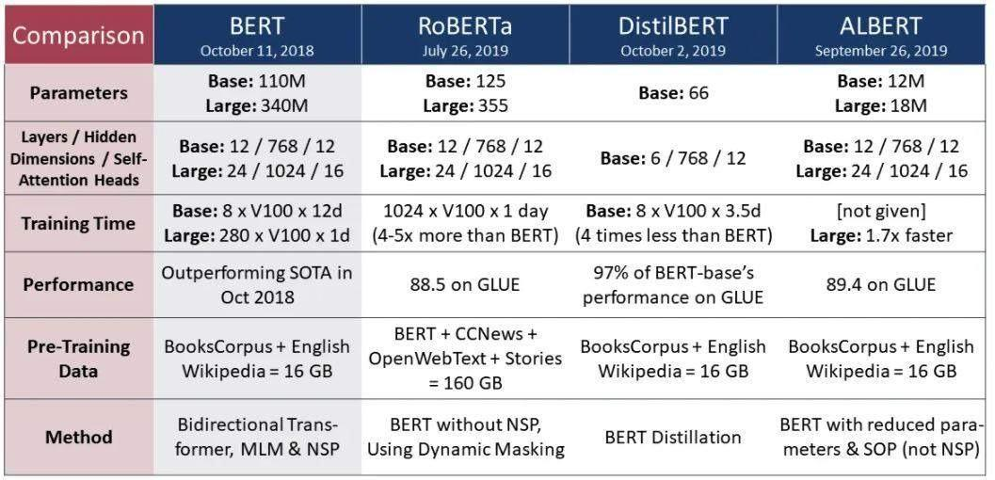
Why BERT? [5]
A Comparison of BERT with other versions of language processing models is given below:

Slide 30
Why BERT? [5]
According to the previous comparison, we can conclude that BERT is the best model for our project due to the following factors:
Model Size and Efficiency: BERT, with its Base model having 110M parameters, is more efficient compared to other models like RoBERTa (Base: 1.25M), DistilBERT (Base: 66M), and ALBERT (Base: 11M). This is crucial for our project, considering we are working with a relatively smaller dataset of a few thousand memes.
Training Time: BERT, with a training time of 8 x V100 x 12d for the Base model, is suitable for training on Google Colab, which is a cloud-based platform with resource limitations compared to specialized hardware, which we have used for the resource extensive task of training the model.
Performance: BERT has demonstrated superior performance, outperforming the state-of-the-art models in October 2018. This is a crucial factor for meme-based cyberbullying detection, as accuracy and effectiveness are paramount in handling real-world scenarios.

Slide 31
Why BERT? [5]
According to the previous comparison, we can conclude that BERT is the best model for our project due to the following factors:
4. Adaptability to Dataset Size: BERT's robust performance on a smaller dataset, such as our few thousand memes, makes it a suitable choice. The model's ability to capture complex language patterns is valuable when dealing with the diverse and often nuanced language present in memes.
5. Pre-training Data Method: BERT's pre-training data method, which includes BooksCorpus and English Wikipedia totaling 16GB, aligns well with the project's dataset size. Moderate-sized pre-training dataset contributes to better generalization on a specific task without the need for excessively large datasets.
6. Fine-Tuning Capability: BERT's bidirectional context understanding and fine-tuning capability make it adaptable to specific tasks like cyberbullying detection. This is crucial for training the model on our custom dataset, allowing it to learn the nuances of hateful and non-hateful memes effectively.

Slide 32
Contextual Understanding for Cyberbullying Detection
In cyberbullying detection, nuanced language, sarcasm, and coded expressions pose challenges.
Traditional keyword methods struggle; BERT's bidirectional processing and contextual comprehension excel.
BERT identifies subtle cues, addressing overt and covert cyberbullying content.
Fine-tuning may be needed for the model to grasp unique linguistic features in memes for effective cyberbullying detection.

Slide 33
Contextual Understanding for Cyberbullying Detection
In cyberbullying detection, nuanced language, sarcasm, and coded expressions pose challenges.
Traditional keyword methods struggle; BERT's bidirectional processing and contextual comprehension excel.
BERT identifies subtle cues, addressing overt and covert cyberbullying content.
Fine-tuning may be needed for the model to grasp unique linguistic features in memes for effective cyberbullying detection.

Slide 34
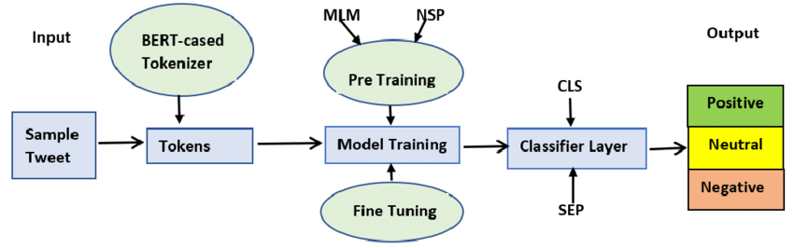
BERT Language Representation [5]
In the process of detecting cyberbullying content within memes, the extracted text goes through a critical phase of encoding. This step involves utilizing a sophisticated language representation model known as BERT (Bidirectional Encoder Representations from Transformers). BERT's advanced capabilities in understanding context and semantics play a pivotal role in capturing the intricate nuances of language, enabling us to identify potential cyberbullying cues.
Non-
Offensive
Sample Text
Offensive

Slide 35
Language is not enough
Output is not cyberbullying
Might be wrong
😠
When you pour a bowl of coco puffs and realize you’re outta milk.
OUR SYSTEM
😊

Slide 36

Language is not enough
Output is cyberbullying
Image context also matters
😠
OUR SYSTEM
😊
Reference

Slide 37
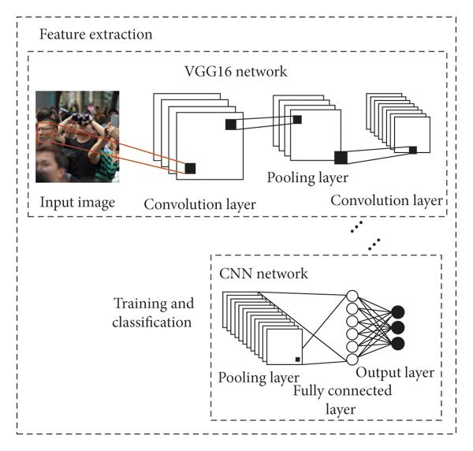
Image Extraction: VGG- 16 Convolutional Neural Network (CNN) [5]
The algorithm utilizes the VGG-16 Convolutional Neural Network (CNN) model for analyzing visual components.
VGG-16, developed by the Visual Geometry Group at the University of Oxford, is renowned for image analysis.
The "16" in its name denotes the number of weight layers, making it deeper and capable of capturing intricate visual patterns.
This architecture is employed to extract relevant features for the detection task related to visual content.

Slide 38
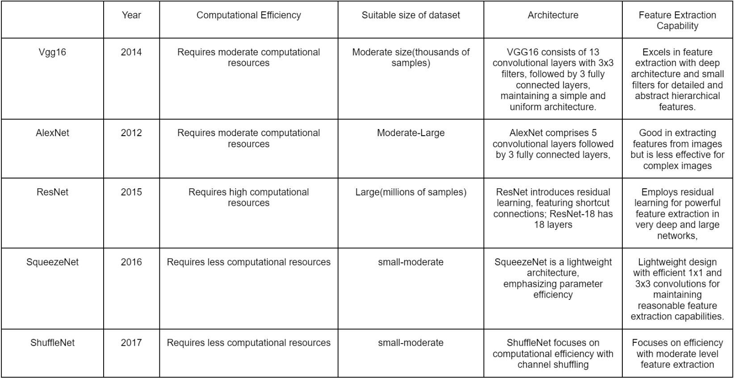
Image Extraction: VGG- 16 Convolutional Neural Network (CNN) [5]

Slide 39
Image Extraction: VGG- 16 Convolutional Neural Network (CNN) [5]
VGG-16 is considered effective for image analysis due to:
Deep Architecture: With 16 weight layers, VGG-16 is deeper than many earlier models, allowing it to capture intricate visual patterns more effectively.
Simplicity: VGG16 has a straightforward and simpler architecture with only 3x3 convolutional layers and max-pooling layers. This simplicity is advantageous in terms of implementation and interpretability over its alternatives.
Versatility: Its generic architecture makes it versatile for various computer vision tasks, including feature extraction for detection tasks.
Strong Performance: VGG-16 has demonstrated strong performance in image classification and feature extraction tasks, contributing to its widespread adoption in the computer vision community.

Slide 40
Image Extraction: VGG- 16 Convolutional Neural Network (CNN) [5]
Transfer Learning: VGG16 has been pre-trained on large datasets like ImageNet. We can leverage the pre-trained weights to extract meaningful features from memes, even when we have a limited dataset for your specific task.
Suitability for Moderate-sized Datasets: VGG16 can perform well with moderate-sized datasets, which is often the case in specific domains or projects where collecting a massive amount of labeled data may be challenging while while Resnet is a more complex and powerful model used for large and complex datasets and requires more computationally intense resources

Slide 41
Training of VGG-16 and Feature Extraction [5]
The algorithm employs a pretrained version of the VGG-16 CNN on the ImageNet dataset.
ImageNet is a large dataset with millions of labeled images across thousands of classes.
Pretraining on ImageNet enables the VGG-16 model to learn diverse visual features transferable to various image-related tasks.
Features are extracted from the last hidden layer before the output layer.
These dimensions represent abstract and high-level features, ranging from basic edges and textures to more complex structures like shapes, objects, and patterns.
ImageNet dataset: https://www.kaggle.com/competitions/imagenet-object-localization-challenge/data

Slide 42
Combining Text and Image Modalities [5]
Harmful content can manifest through text, images, or their combination.
Merging text and image analyses provides a comprehensive view of potential cyberbullying cues.
Encoded text features from BERT and image features from VGG-16 are concatenated into a single feature vector.
This vector forms a combined representation of the meme, capturing both linguistic nuances and visual patterns.
Concatenation fuses feature spaces into a unified, higher-dimensional representation, facilitating the capture of complex interactions between textual and visual content.

Slide 43
Multimodal Feature Vector [5]
Concatenated feature vector combines text (BERT) and image (VGG-16) encodings.
Text encoding has 768 dimensions; image encoding has 4096 dimensions.
Multimodal feature vector is 4,864 dimensions (768 + 4096).
Fusion enables algorithm to identify alignment or contradiction between text and visual elements.
This deepens understanding of meme context, crucial for detecting potentially harmful content that might be obscured by focusing on only one modality.

Slide 44
Multi Layer Perceptron (MLP) [5]
MLP architecture comprises two hidden layers with 100 neurons each.
Architecture choice balances complexity and computational efficiency.
More complex architectures may improve accuracy but pose risks like overfitting and increased computational demands.
Hate speech detection is the final stage, predicting cyberbullying likelihood in memes.

Slide 45
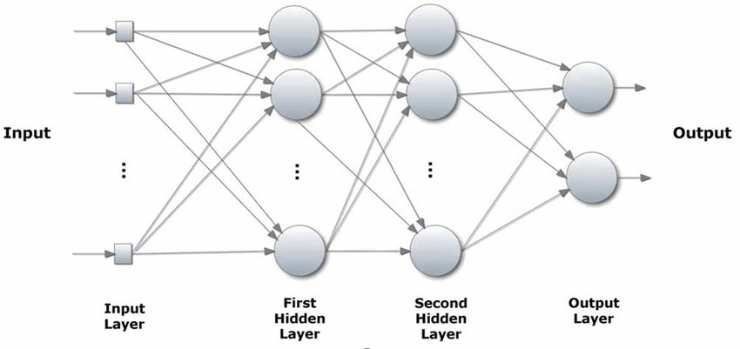
Multi Layer Perceptron
Reference

Slide 46
ReLU and Output [5]
The Rectified Linear Unit (ReLU) is a popular activation function that introduces non-linearity into the neural network. ReLU activation sets all negative input values to zero and retains positive values. This activation function has been shown to be effective in mitigating the vanishing gradient problem and speeding up convergence during training.
The final output of the MLP is a single neuron. This neuron produces a prediction score that reflects the likelihood of cyberbullying content being present within the meme. The higher the output score, the higher the probability of the meme containing harmful content. The score can be interpreted as a measure of confidence in the algorithm's prediction.

Slide 47
Advantages of this Model
Using pre-trained models such as BERT which will increase accuracy.
Added image context to better identify the context of memes with images and text and better deduction as a result.
Using images from both hateful and non-hateful meme datasets to better identify the memes.
Using the latest technology such as VGG-16 and Bert.
Using Tesseract 4.0.0 OCR Tool to efficiently and accurately perform OCR on the memes.
[5]
[6]

Slide 48
Limitations of the Model
[5]
The performance of the algorithm heavily relies on the quality, diversity, and size of the training dataset. If the training data doesn't encompass a wide range of meme variations and hate speech examples, the algorithm might struggle to generalize effectively to real-world scenarios.
Although BERT is powerful, it might still struggle with fully grasping sarcasm, irony, and cultural references within memes. These nuances are challenging even for humans to detect, and the model might misinterpret them, leading to false positives or negatives.
The effectiveness of OCR and image processing steps depends on the quality of preprocessing. Poor image resolution, complex meme layouts, and text overlays could hinder text extraction and image feature extraction, impacting the final results.

Slide 49
Limitations of the Model
[6]
Processing large volumes of memes in real-time or near-real-time might be resource-intensive.
The algorithm might struggle with memes that are heavily context-dependent. Without broader context, a meme might appear offensive when it's actually part of a larger conversation that renders it harmless.
The online landscape and language usage evolve over time. Regular updates to the algorithm, training data, and model fine-tuning are necessary to maintain its accuracy and effectiveness.
Users might perceive false positives or negatives as inaccuracies in the algorithm's judgment. Gathering user feedback and continuously improving the model based on real-world experiences is essential.

Slide 50
Limitations of the Model
[6]
Bias and Ethical Concerns: Automated hate speech detection may introduce biases and ethical concerns, leading to potential misclassification.
Misuse for Hate Speech Creation: There's a risk of the algorithm being misused to assess hate scores for text-image pairs, potentially aiding in the creation of harmful content.
Adaptation by Cyberbullies: Cyberbullies may employ sophisticated techniques like coded language or memes, diminishing the effectiveness of current detection features.

Slide 51
Work Done after C2
We made changes in the internal design of the hidden layers (increased the number of neurons) and increased the number of epochs while training to increase the accuracy of the final model created from 84.98 % to 92.06 %.
We added a graphic user interface (GUI) with the trained model, which can take an image as the user input, and classify it as offensive or non-offensive.
Included comparison for different versions of BERT to justify that it is the best tool for our project, considering the scale of our project.
Compared different alternatives for performing Optical Character Recognition and selected the Tesseract 4.0.0 OCR tool as the best alternative for our use.
Included comparison of VGG16 with other image feature extraction models, like AlexNet, ResNet and others.

Slide 52
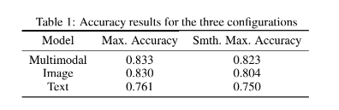
Results and Conclusion
Results of the base Paper
Smth. Max Accuracy is the smoothened or converging accuracy of models when recorded multiple times
Max. Accuracy is the Maximum accuracy of Models recorded in any iteration.

Slide 53
Results and Conclusion
Previous Model Performance Overview:
Model 1 (Using only Text Features)
Trained on extracted text from memes.
Accuracy: 72.97845611539527%
Model 2 (Image Features)
Trained on image features extracted using VGG-16.
Accuracy: 80.61751946867736%
Model 3 (Combined Features)
Trained on both image (VGG-16) and text (BERT) features.
Accuracy: 84.98567294673194%

Slide 54
Results and Conclusion
To increase the accuracy of the model, we increased the no. of training epochs from 50 to 100 and the number of neurons in each hidden layer from 50 to a 100.
New Model Performance Overview:
Model 1 (Using only Text Features): Trained on extracted text from memes.
Accuracy: 77.94760320663452%
Model 2 (Image Features): Trained on image features extracted using VGG-16.
Accuracy: 84.97895167350769%
Model 3 (Combined Features): Trained on both image (VGG-16) and text (BERT) features.
Accuracy: 86.96432278633118%

Slide 55
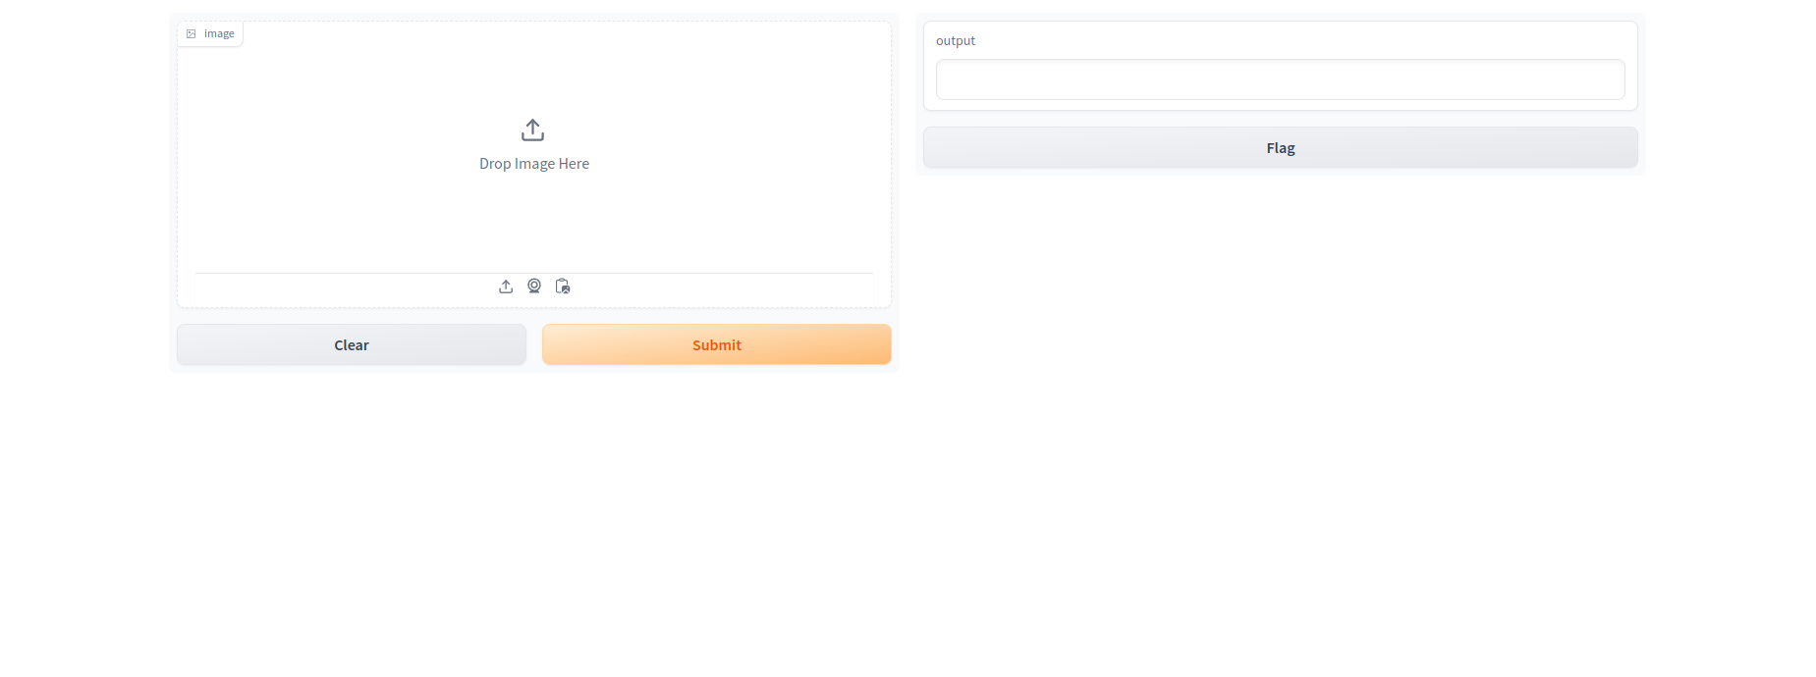
Results and Conclusion - UI

Slide 56
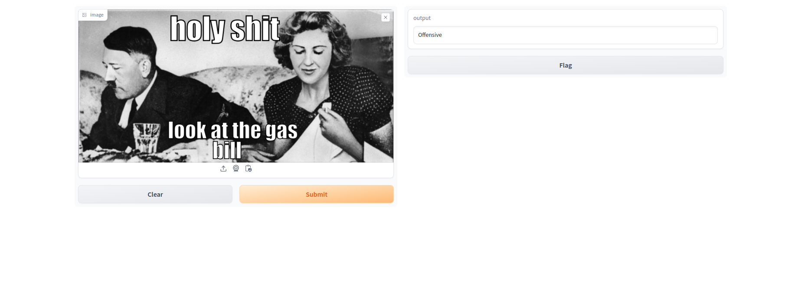
Results and Conclusion - UI
MEME CLASSIFICATION - OFFENSIVE

Slide 57
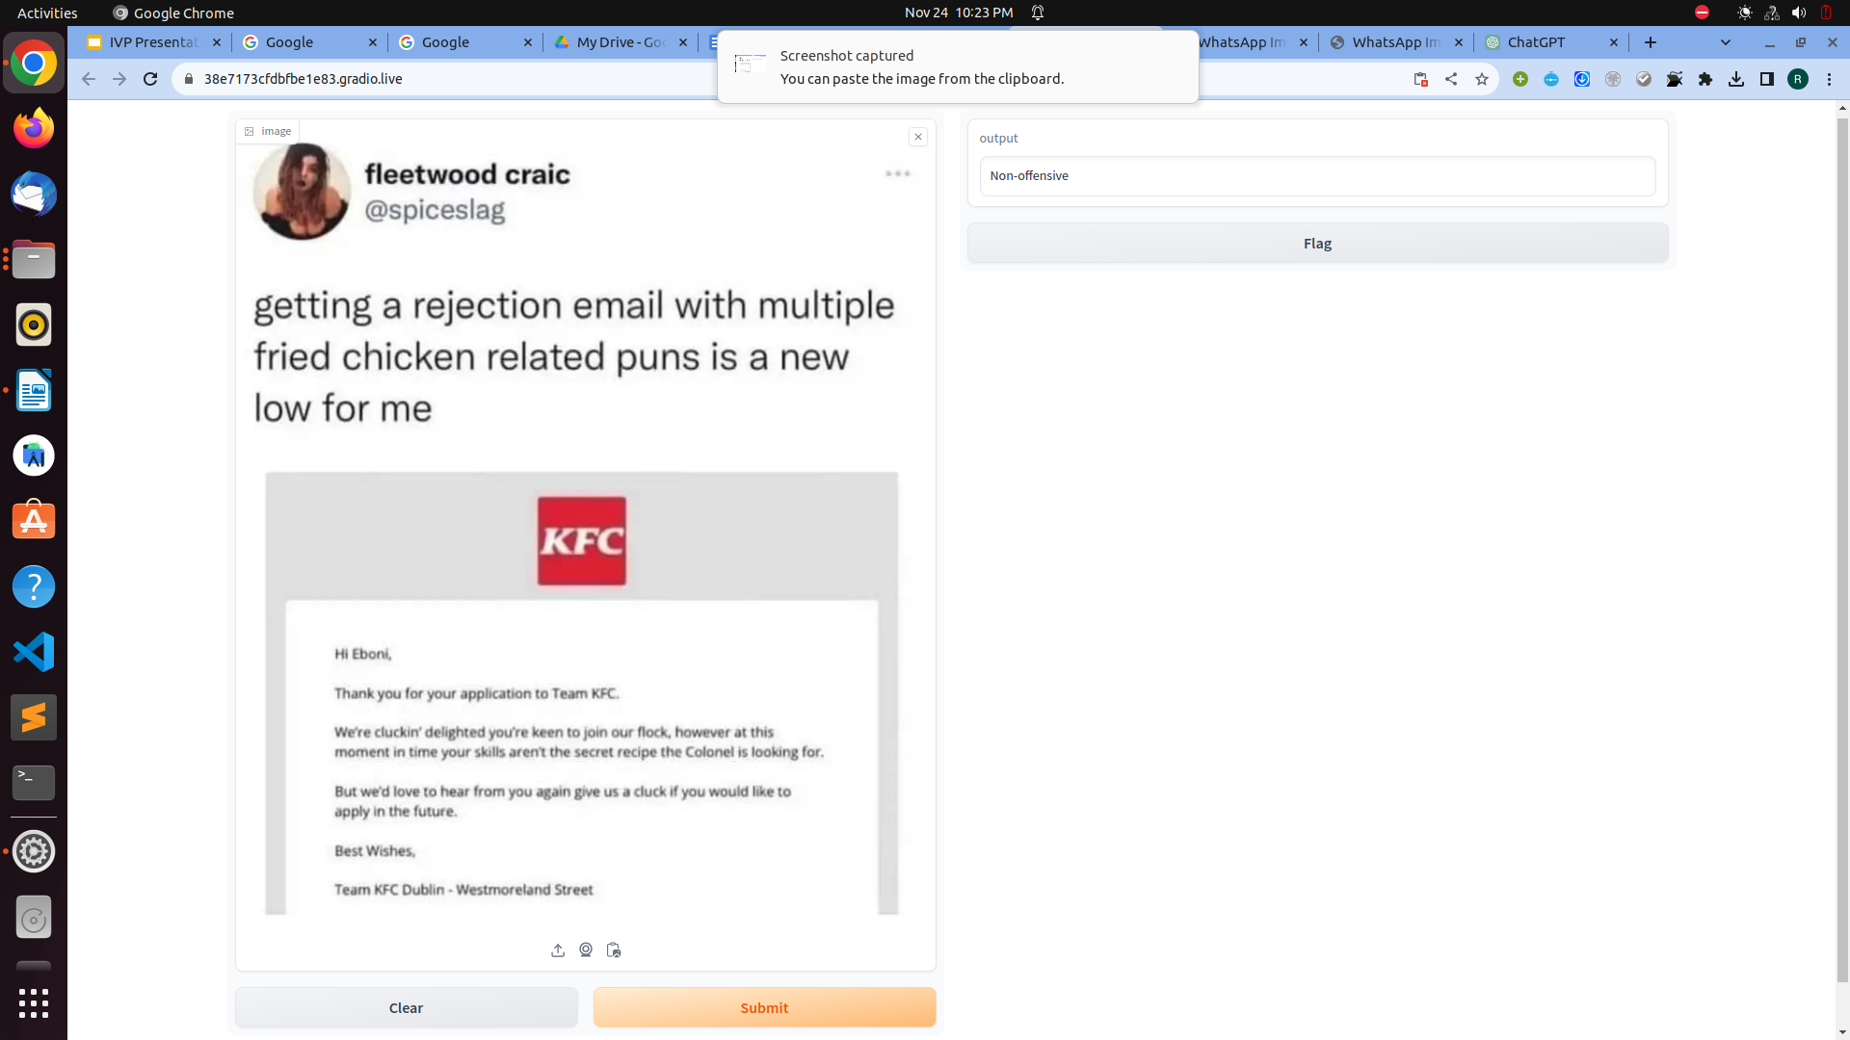
Results and Conclusion - UI
MEME CLASSIFICATION - NON-OFFENSIVE

Slide 58
Results and Conclusion
Based on the results of the papers and model that we deduced, we can say that visual modality is more important than language.
In simpler words, context in the image matters.
Dataset bias might be present, as the model will be trained on a specific database.
Memes often present visual effects and distortions that damage the OCR performance.
Will decrease in effectiveness as time goes on and new memes originate.

Slide 59
Results and Conclusion
Key Observations:
The model utilizing both image and text features (Model 3) demonstrated the highest accuracy.
Model 2, which relied solely on image features, performed significantly better than Model 1, indicating the importance of visual data in cyberbullying detection.
Significance of Combined Features
The integration of both text and image features allows for a more comprehensive understanding of meme content.
This holistic approach proves to be crucial in accurately identifying instances of cyberbullying.

Slide 60
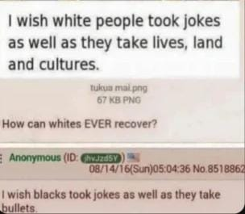
Results and Conclusion
Deduces Correctly
But…..
😠
OUR SYSTEM
😊
Reference

Slide 61

Results and Conclusion
Might Work???
😠
OUR SYSTEM
😊
Reference

Slide 62
Future Scope of Project
Cross Lingual Analysis: The model can be extended to support multiple languages, considering the global nature of online communications.
Incremental Learning: These include learning techniques, that allow the model to adapt to to new data over time. This is useful in dynamic online environments, where the nature of the offensive content may change.
Semantic Advancement: New Natural Language Processing (NLP) Models can be used to enhance the model's understanding of the semantic context within memes.

Slide 63
References (¼)
An approach to detect offence in Memes using Natural Language Processing(NLP) and Deep learning
Authors: Roushan Kumar Giri, Subhash Chandra Gupta, Umesh Kumar Gupta
Source: https://sci-hub.se/https://ieeexplore.ieee.org/document/9402406
2. Exploring Hate Speech Detection in Multimodal Publications
Authors:Raul Gomez, Jaume Gibert, Lluis Gomez, Dimosthenis Karatzas Eurecat, Centre Tecnologic de Catalunya, Unitat de Tecnologies Audiovisuals, Barcelona, Spain, Computer Vision Center, Universitat Autonoma de Barcelona, Barcelona, Spain
Source: https://arxiv.org/pdf/1910.03814.pdf

Slide 64
References (2/4)
3. Multimodal Meme Dataset (MultiOFF) for Identifying Offensive Content in Image and Text
Authors: Shardul Suryawanshi, Bharathi Raja Chakravarthi, Mihael Arcan, Paul Buitelaar
Source: https://aclanthology.org/2020.trac-1.6.pdf
4. Racist or Sexist Meme? Classifying Memes beyond Hateful
Authors: Haris Bin Zia, Ignacio Castro, Gareth Tyson
Source: https://aclanthology.org/2021.woah-1.23.pdf

Slide 65
References (¾)
5. Hate Speech in Pixels: Detection of Offensive Memes towards Automatic Moderation
Authors: Benet Oriol Sabat, Cristian Canton Ferrer, Xavier Giro-i-Nieto
Source: https://arxiv.org/pdf/1910.02334.pdf
6. AOMD: An Analogy-aware Approach to Offensive Meme Detection on Social Media
Authors: Lanyu Shang, Yang Zhang, Yuheng Zha, Yingxi Chen, Christina Youn, Dong Wang
Source: https://arxiv.org/pdf/2106.11229.pdf

Slide 66
References (4/4)
7. Disentangling Hate in Online Memes
Authors: Roy Ka-Wei Lee, Rui Cao, Ziqing Fan, Jing Jiang, Wen-Haw Chong
Source: https://dl.acm.org/doi/pdf/10.1145/3474085.3475625
8. DISARM: Detecting the Victims Targeted by Harmful Memes
Authors: Shivam Sharma, Md. Shad Akhtar, Preslav Nakov, Tanmoy Chakraborty
Source: https://aclanthology.org/2022.findings-naacl.118.pdf
9. https://github.com/imatge-upc/hate-speech-detection/blob/master/slides.pdf
10. https://en.wikipedia.org/wiki/Cyberbullying
11. https://en.wikipedia.org/wiki/Meme
12. https://shorturl.at/npsMV

Slide 67
THANK YOU!!!

